Slide 1
AI-2002 AI Project Prtesentaiton
Fajr Naveed – 18I-0436
Muhammad Taimur– 19I-0674
Ahmad Arif – 18I-1661

Slide 2
Dataset Geenration
We generated multiple datasets to work with our model
The dataset was created using pandas on .csv
Keyboard library was used to manually run the car
Multiple datasets were created on .txt to work with

Slide 3
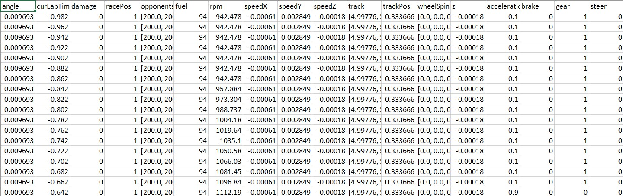
Dataset Geenration

Slide 4
Data Preprocessing
For data preprocessing we used Keras and TensorFlow libraries to train the dataset
The movement of AI model was based on the sensors and the actuator values predicted the best move.
We however failed to load our .csv file successfully onto the model because of the lists that generated during creation of dataset.
The track and opponent sensors created a list that were unable to load onto TensorFlow.

Slide 5
Feature Selection
The features selected to move the car automatically were its sensors and the actuators that controlled the car.
We selected more features in hope that we would be able to train the model quickly based on the number of sensors in the dataset.

Slide 6
Model selection
The model we selected was tensor flow
We chose it because of its vast libraries and functions to easily work with
However the model failed to load list onto TensorFlow which caused problems for us.

Slide 7
Results
We were successful in creating dataset in .csv
The dataset was unable to import onto TensorFlow due to lists being created in the dataset
We tried to import dataset onto Keras using .txt but that didn’t work
The car was unable to be driven automatically

Slide 8
Model Integration
The dataset was created using pandas, creating .csv and.txt
The model was not able to load the dataset created
The model failed to run the car automatically

Slide 9
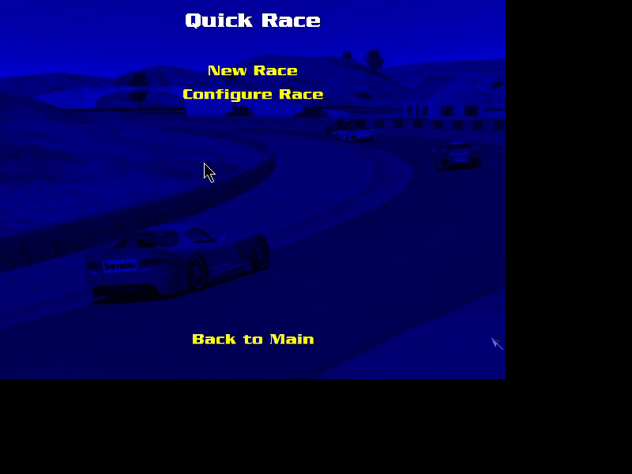
Demo

